Slide 1
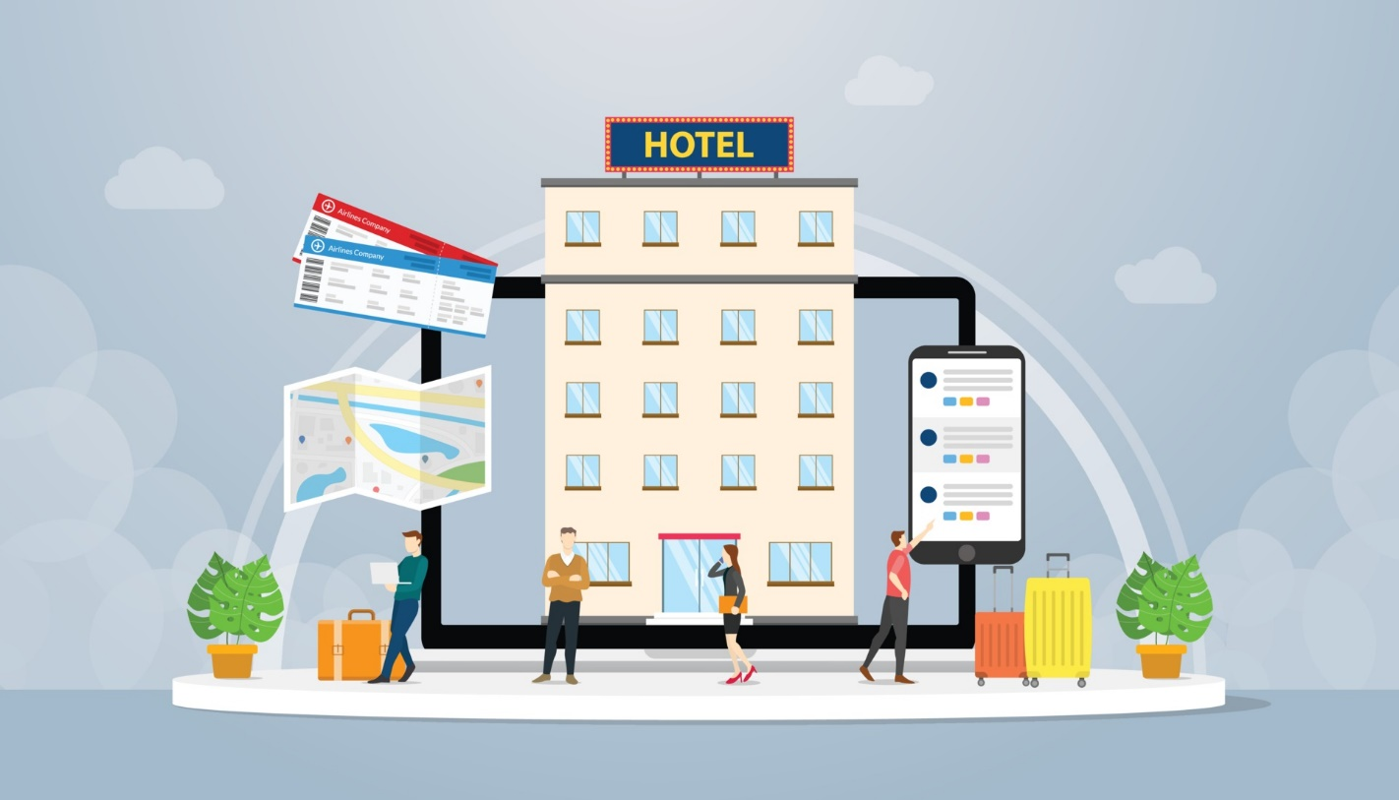
Hotel Reservation
A hotel reservation is the process of making a booking for a room in a hotel. This can be done online, through a travel agent, or by contacting the hotel directly. When making a reservation, you will need to provide the hotel with the following information:
Your name
The number of people in your party
The dates of your stay
The type of room you would like
Your credit card information (to guarantee your reservation)
Once you have made a reservation, you will receive a confirmation email. This email will contain your reservation number, the name of the hotel, the dates of your stay, the type of room you have reserved, and the total cost of your stay.

Slide 2
Problem Statement
The hospitality industry, particularly hotel management, faces an array of challenges in understanding and optimizing customer interactions to enhance operational efficiency and customer satisfaction. In this context, our project aims to leverage hotel reservation data to uncover key insights and address critical questions that will contribute to informed decision-making. The following are the focal points of our investigation:
Room Types and Meal Plans Preferences: Determine the most favored room types and meal plans among customers to tailor offerings and enhance customer satisfaction.
Lead Time and Cancellation Risk: Investigate the impact of lead time on the likelihood of reservation cancellations, enabling the hotel to optimize resource allocation and revenue management.
Cancellation Reasons and Mitigation Strategies: Identify common reasons for reservation cancellations and propose strategies to address these issues, aiming to reduce the overall cancellation rate and enhance revenue retention.
Temporal Booking Patterns: Analyze booking trends over time, including seasonal variations and market segment changes, to optimize marketing strategies and operational planning.
Average Revenue Metrics: Calculate the average revenue per reservation and quantify the average revenue loss due to cancellations, providing a clear understanding of the financial impact.
Monthly Revenue Fluctuations: Determine the month with the highest revenue loss compared to gains, enabling the hotel to implement targeted measures during peak cancellation periods.
December Lead Time Analysis: Investigate the average lead time of booking cancellations and non-cancellations specifically in the month of December, helping the hotel prepare for the holiday season.
Guest Demographics and Preferences: Understand how the number of adults, children, and special requests influence room and meal plan selections, allowing for personalized offerings.
dang revenue through dynamic pricing strategies.

Slide 3
Booking Trends by Day and Time: Identify popular days of the week and times of the year for hotel bookings, facilitating strategic pricing and resource allocation.
Pricing Dynamics: Explore how prices vary based on the time of year, day of the week, and lead time, optimizing revenue through dynamic pricing strategies.
Repeat Guest Influence: Evaluate the impact of being a repeated guest on booking behavior and cancellation rates, guiding loyalty program enhancements.
Parking Space Availability: Investigate the correlation between the availability of car parking space and booking behavior, identifying potential areas for improvement.
By addressing these questions, our analysis aims to provide actionable insights for the hotel management team, ultimately supporting them in refining operations, enhancing customer experiences, and increasing overall revenue.

Slide 4
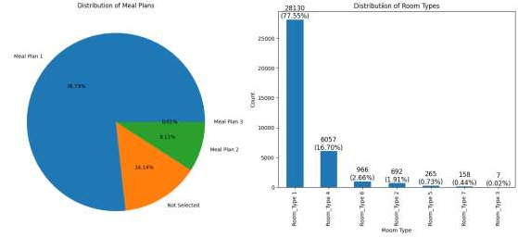
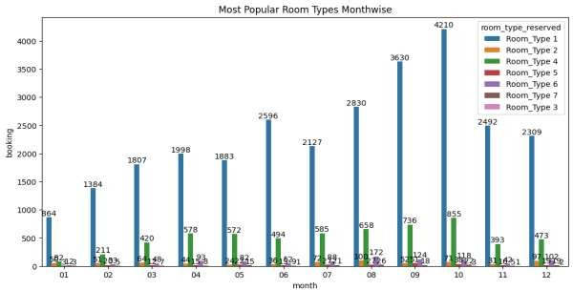
Hotel Reservation Analysis Report
The Popular Meal Plan and Room Type
most popular meal plans are meal plan 1 and meal plan 2 and we can see the most popular room types are room type 1 and room type 4 and most popular meal plans are meal plan 1 and meal plan 2.
Let’s check most popular room types monthwies

Slide 5
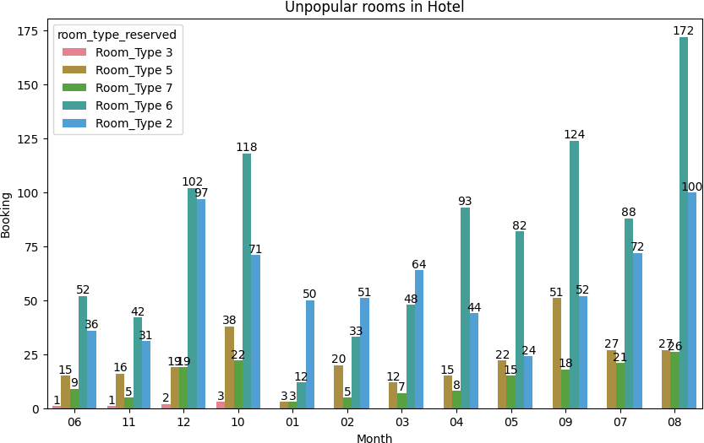
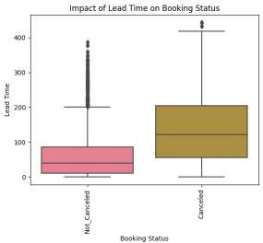
Although there are seven room types in this data, the bar chart shows that Room Type 1 is the most popular room type every month, with the highest number of bookings in October (4,210). Room Type 4 is the second most popular room type every month, with the highest number of bookings in December (855).
Let’s check unpopular types of Rooms
The bar chart shows that Room Type 3 is the least popular room type, with only 1 booking in June, 3 bookings in October, 1 booking in November, and 2 bookings in December.
Lead Time Impact on Cancelation Overall impact

Slide 6
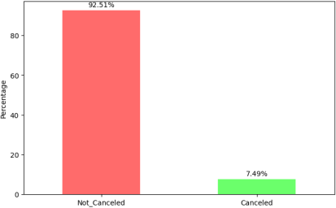
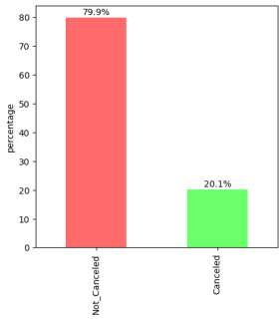
The figure above indicates that there is an impact of lead time on booking status. The data shows that as lead time increases, the cancellation rate also tends to increase. Now, let's calculate the cancellation rate for lead times less than 2 days. Additionally, we can also analyze the impact of lead times equal to or greater than 100 on the cancellation rate.
The figure indicates that if the customer books the hotel two days before their desired date, the chances of cancellation rate are only 7.5%, suggesting a low probability of cancellation.
Let’s find If a customer books a hotel one month in advance, how much does it impact the cancellation rate?"
If a customer books a hotel one month (30 days) in advance, the chances of cancellation rate increase compared to booking a hotel just 2 days before the desired date.

Slide 7
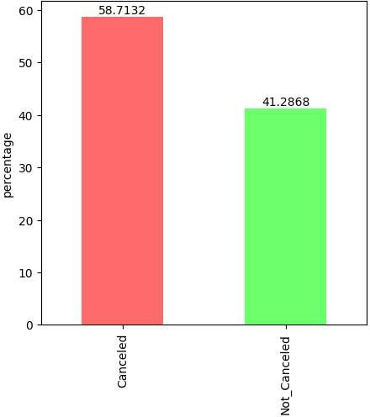
Let's identify the impact on the cancellation rate when a customer books a hotel 100 days in advance before their arrival.
The figure above demonstrates that if a customer books a hotel 100 days before their arrival, the chances of the cancellation rate exceeding 58% are significant, indicating a substantial increase. Let's identify the impact on the cancellation rate when customers book hotels 200 days before their arrival.

Slide 8
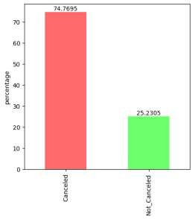
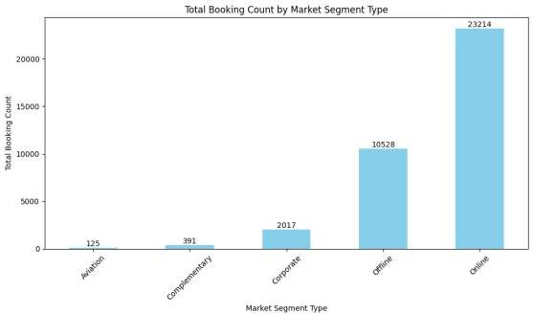
We can see from the figure that if customers book the hotel 200 days before their arrival, the chances of the cancellation rate increasing go up to 70%, which is a significant increase.
Trends in Booking Pattern Seasonal variation and Market Segment
Total booking counts by market segment type
The above figure shows that the majority of customers arrive from the online market segment, with 23,214 arrivals. The offline market segment is the second most popular,

Slide 9
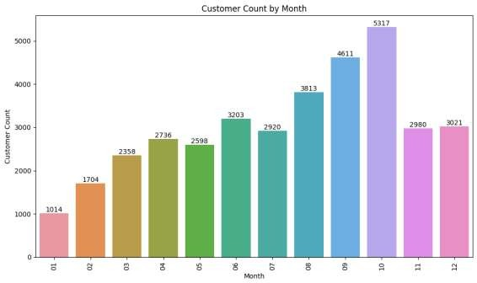
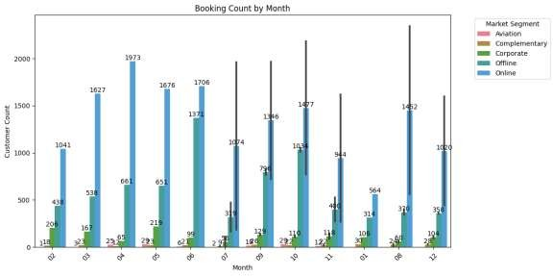
with 10,528 arrivals. The corporate market segment is the least popular, with 2,017 arrivals.
Let’s see Total customer count by month
The figure shows that the customer count increased by 1 each month from month 1 to month 4. In month 5, there was a slight decrease, followed by an increase in month 6. There was another slight decrease in month 7, followed by 1-unit increases in months 8, 9, and 10. The customer count decreased in months 11 and 12, but the decrease was not as significant as the decrease in month 5.
Let's see the arrival count by month, segmented by market segment.
The figure shows that the majority of bookings were made through the online market segment every month. The highest number of arrivals through the online market segment

Slide 10
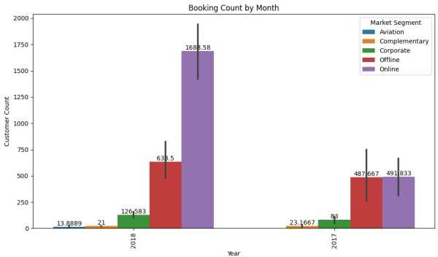
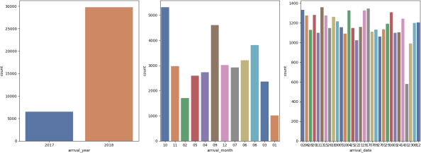
was in October, with 2,954 arrivals. The highest number of arrivals through the offline market segment was also in October, with 2,068 arrivals. The highest number of arrivals through the corporate segment was in September, with 258 arrivals.
Let's see the arrival count by Year, segmented by market segment.
Total customer count by year, month, and arrival date
The above figure shows the most customer arrivals on October 11, 2018.
Most popular months for same-day hotel bookings

Slide 11
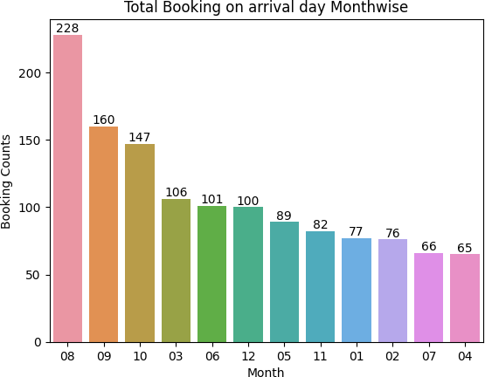
The figure shows that October has the highest number of bookings with a lead time of less than 1 day, also known as same-day bookings.
the October month booking status
* Analysing the lead time impact on the October month
Average lead time of October customers: 96.13139260424862
Average lead time of customers who cancelled the booking: 143.2594086021505 3
Average lead time of customers who did not cancel the booking: 65.969462365 5914
market_segment_type booking_status
0 Corporate 26
1 Offline 173
2 Online 1289
if the customer average lead time greater than 143 days before the arrival the chances cancelation increase, when the average lead time less then 65 days before the arrival the chances of cancelation increase
the above table show most of the cancelation done via online market segment 1289 this was huge number and the second highest is offline market segment 173, corporate 26 cancelation

Slide 12
In-depth analyzing the October month

Slide 13
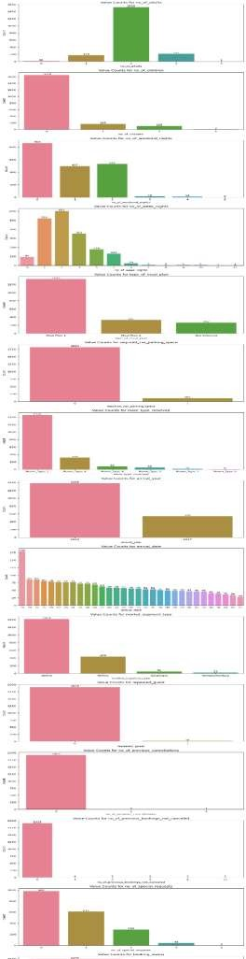

Slide 14
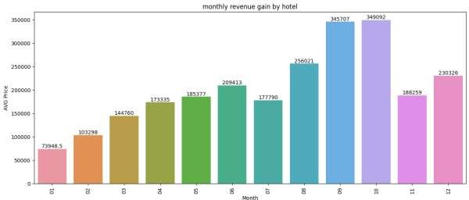
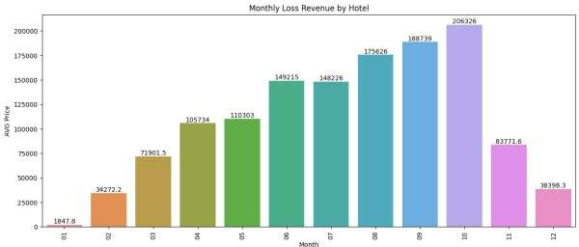
Average revenue per reservation for a hotel
* Monthly revenue
We can see that the graph shows the highest revenue gains in September (345,707 euros) and October (349,092 euros) due to a lot of bookings and customer arrivals during these months.
* Average revenue Loss due to Cancelation
The above graph shows that average revenue losses in September (188,739 euros) and October (206,326 euros) were highest during the months with the most arrivals and cancellations.
* Gain vs Loss Revenue

Slide 15
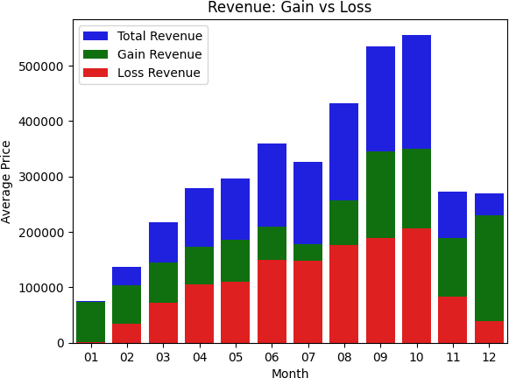
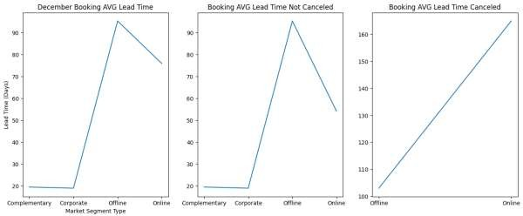
The above figure shows that December has more revenue than lost revenue, with most losses occurring in October compared to gains.
December month avg lead time cancelation and non-cancelation
We can see that the cancellation rate of hotel rooms increases if the ticket is booked through the online or offline segment with a lead time of greater than or equal to 100 days.

Slide 16
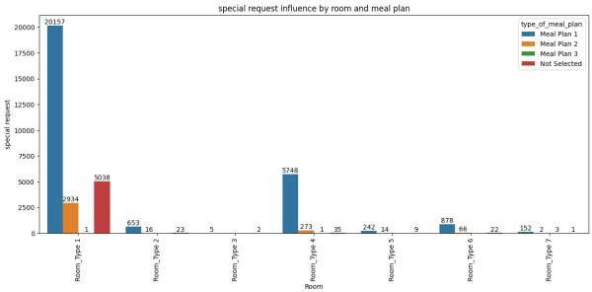
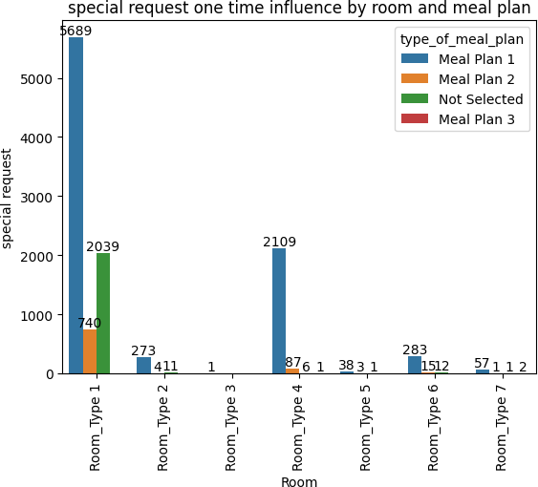
Special request influences the room type and Meal Plan
The above figure shows that most customer special requests are for room type 1 and meal plan 1
1. Let's focus on customers who have given special requests one time.
The figure shows that customers who give one-time special requests prefer room type 1 most, followed by room type 4, and meal plan 1.
2 Now let's check how two-time special requests influence room type and meal plan.

Slide 17
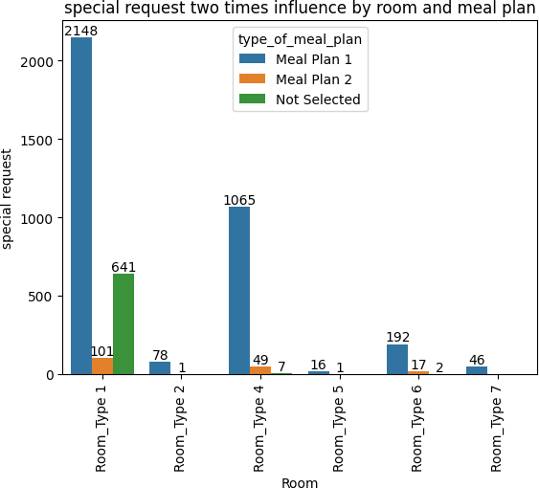
The figure shows that customers who make special requests twice most prefer room types 1 and 4 and meal plan 1.
3. Let's see the three time special request influence the room type and meal plan

Slide 18
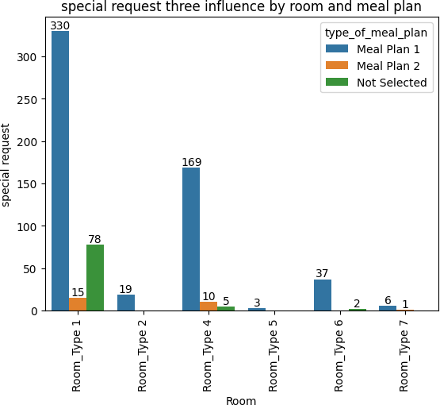
The figure shows that customers who make special requests thrice most prefer room types 1 and 4 and meal plan 1.
4. Let's see the special request four times influence by room and meal plan.

Slide 19
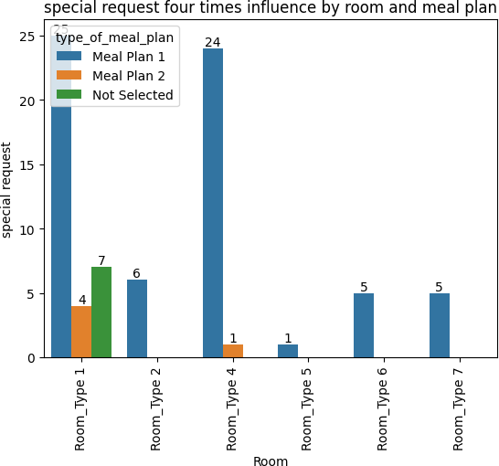
The figure shows that customers who make special requests four times most prefer room types 1 and 4 and meal plan 1.
5. Now let's see five special request five times influences the room type and meal plan

Slide 20
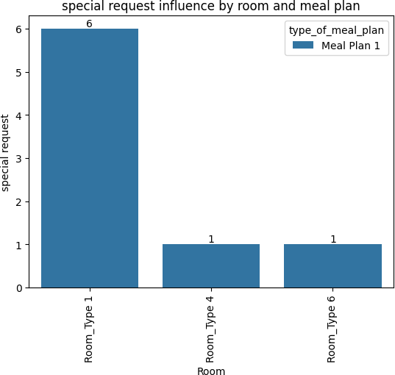
The figure shows that customers who make special requests five times only prefer room types 1 and meal plan 1.
All of the figures show that special requests most often influence customers to choose room types 1 and 2 with meal plan 1.
most popular days of the week and times of year for hotel bookings

Slide 21
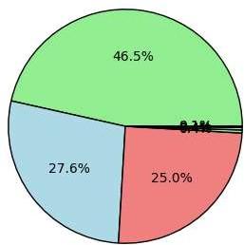
Sunday | 46.512654
Monday | 27.554171
Tuesday | 25.006892
Wednesday | 0.421790
Thursday | 0.355627
Friday | 0.093731
Saturday | 0.055136
the above figure shows Most popular week days
Sunday: 46.5%, Monday: 27%, Tuesday: 25% Other weekdays have very low popularity.
Prices vary depending on time of year, days of the week & Lead Time

Slide 22
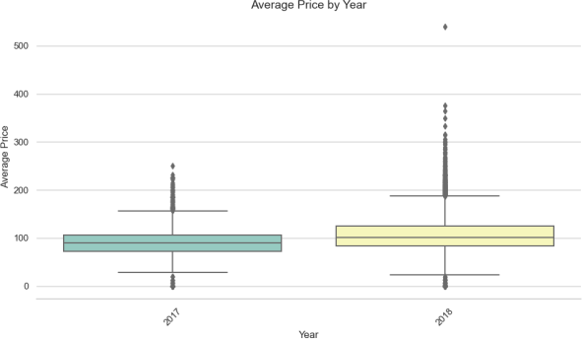
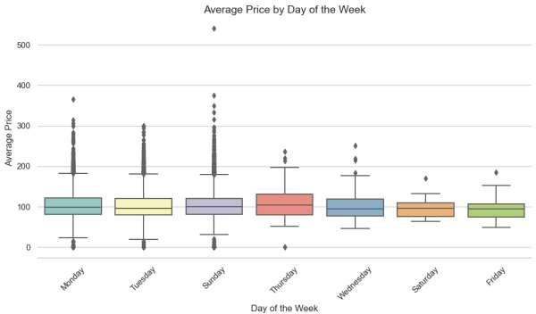
The above figures indicate that in the year 2018, there is a slightly higher average price compared to the year 2017. Additionally, it appears that Thursday has a slightly higher average price than the other weekdays
Room types and the number of customers is factors of average price. So, we can create a group for every room type in this data and create data frames to check the impact of lead time on average price.

Slide 23
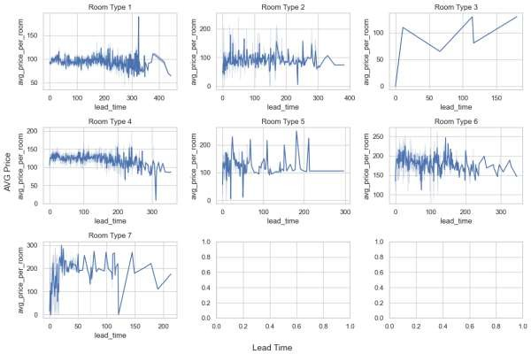
The above figure shows that lead time does not make that much of an impact on average price.
Repeated Guest impact on booking behaviour and cancelation Rates

Slide 24
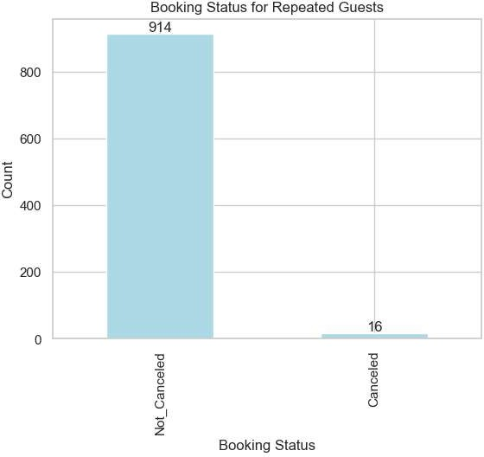
The figure shows that there is no significant impact on booking behaviour, especially in terms of cancellations. In fact, only 16 repeat guests cancelled their bookings out of a total of 930.
Now, let's check which market segment the cancellations are coming from among those who cancelled their bookings.
Market Segment Type | Repeated Guest | Booking Status
Corporate | 1 | 3
Offline | 1 | 6
Online | 1 | 7
Car parking space affect the booking

Slide 25
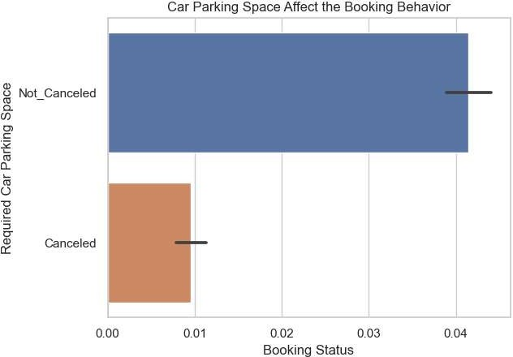
Not_Canceled Cancelled
1010
114
We can see that there is not much impact on booking behavior. Only 114 customers who required car parking space have cancelled their bookings.
Conclusion:
Room types 1 and 4 are the most popular, while room type 3 is the least popular.
Lead time has an impact on cancellation rate, with longer lead times associated with higher cancellation rates.
Customers who book hotels 100 days or more in advance have a high
probability of cancelling (over 58%).
The majority of bookings and customer arrivals come from the online market segment.
October is the busiest month for the hotel, with the most bookings, customer arrivals, and revenue.
Most customer special requests are for room type 1 and meal plan 1.
Customers who give one-time special requests prefer room type 1 most, followed by room type 4, and meal plan 1.

Slide 26
Customers who make special requests four times or more only prefer room types 1 and meal plan 1.
Sunday is the most popular week day for bookings, followed by Monday and Tuesday.
The average price in 2018 is slightly higher than in 2017, and Thursday has the slightly highest average price of the weekdays.
Lead time does not make a significant impact on average price.
There is no significant impact on booking behavior, especially in terms of cancellations, even for repeat guests and customers who require car parking space.
These insights can be used by the hotel to improve its operations and customer satisfaction. For example, the hotel can focus on marketing and selling its most popular room types and meal plans. The hotel can also develop strategies to reduce the number of cancellations, such as offering discounts or incentives to guests who book in advance or who are more likely to cancel. The hotel can also use the insights to improve its pricing strategy and to ensure that it is offering competitive rates.

